Slide 1
Select Scenes for Experimental Results
Sphere Scenes
Mesh Scenes

Slide 2

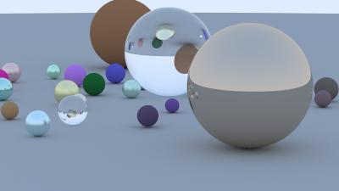
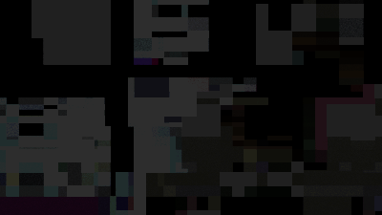
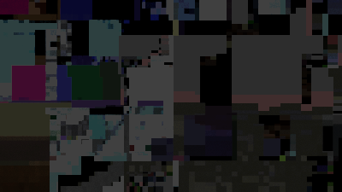
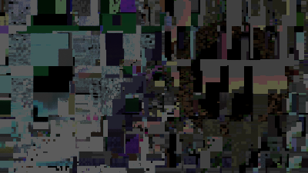
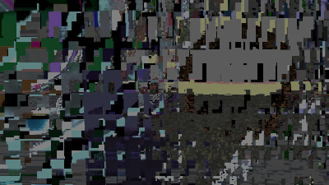
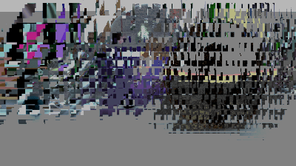
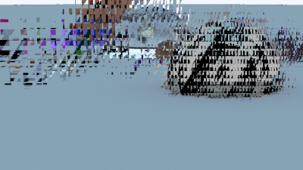
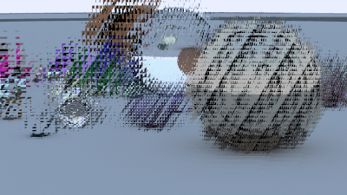
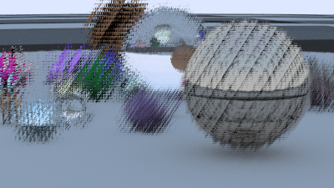
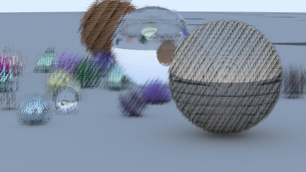
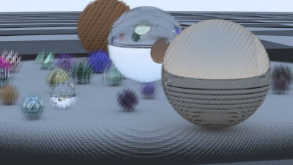
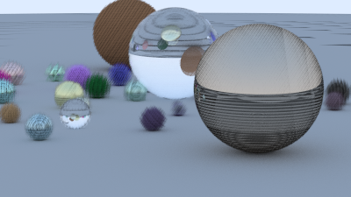
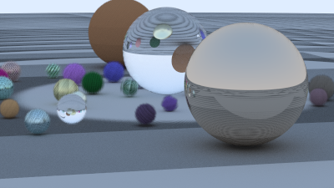




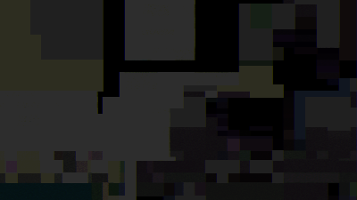
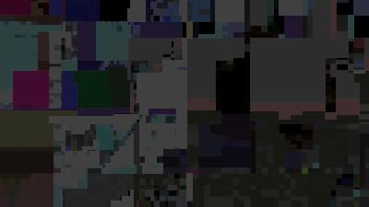
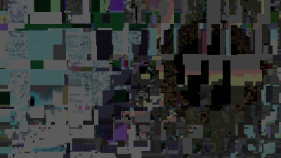
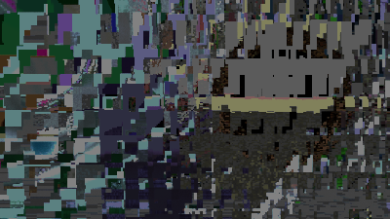
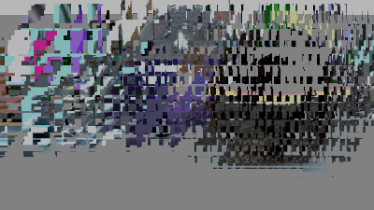
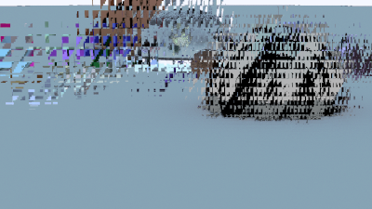
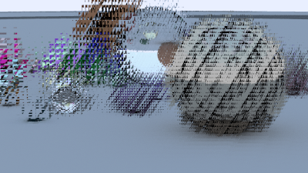



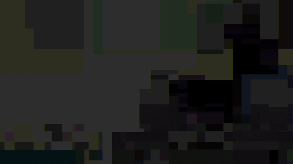
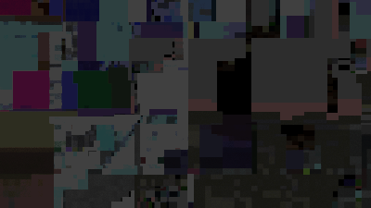




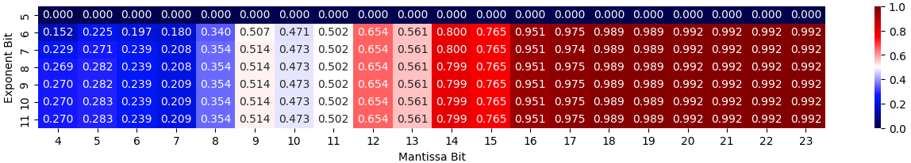
Reduced Precision
Original FP64
Reduced Precision
Reduced Precision
Reduced Precision
Reduced Precision
Reduced Precision
Reduced Precision
Reduced Precision
Reduced Precision
Reduced Precision
Reduced Precision
Reduced Precision
Reduced Precision
Reduced Precision
Reduced Precision
Reduced Precision
Reduced Precision
Reduced Precision
Reduced Precision
Reduced Precision
Reduced Precision
Reduced Precision
Reduced Precision
Reduced Precision
Reduced Precision
Reduced Precision
Reduced Precision
Reduced Precision
Reduced Precision
Reduced Precision
Reduced Precision
Reduced Precision
Reduced Precision
Reduced Precision
Reduced Precision
Original FP64
Original FP64
Original FP64
Original FP64
Original FP64
Original FP64
Original FP64
Original FP64
Original FP64
Original FP64
Original FP64
Original FP64
Original FP64
Original FP64
Original FP64
Original FP64
Original FP64
Original FP64
Original FP64
Original FP64
Original FP64
Original FP64
Original FP64
Original FP64
Original FP64
Original FP64
Original FP64
Original FP64
Original FP64
Original FP64
Original FP64
Original FP64
Original FP64
Original FP64
?
B
Click a SSIM (Similarity) score to check the corresponding image!

Slide 3
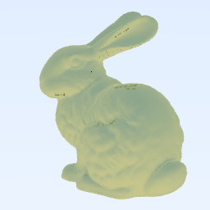



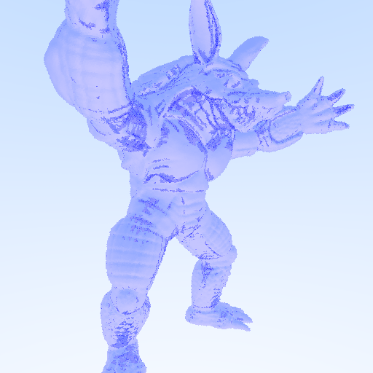

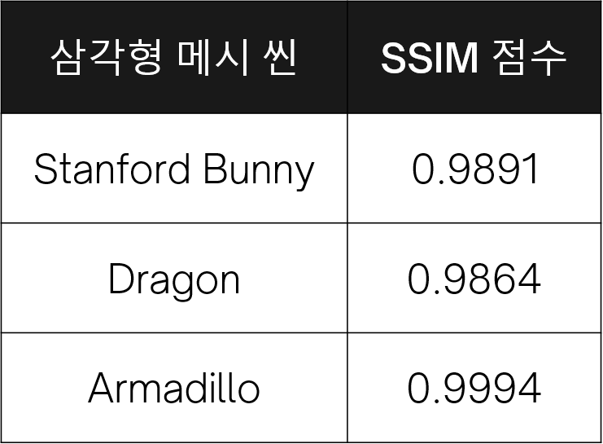
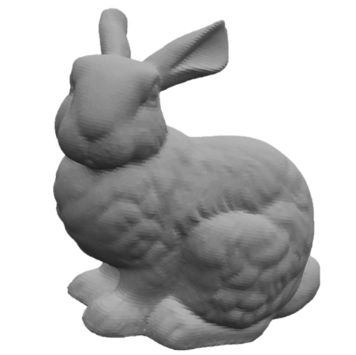
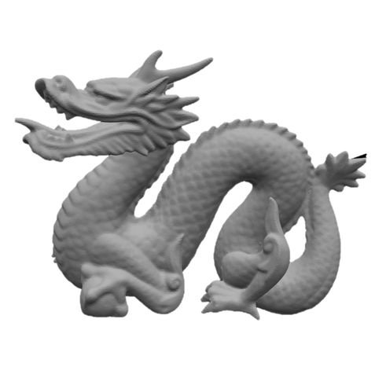
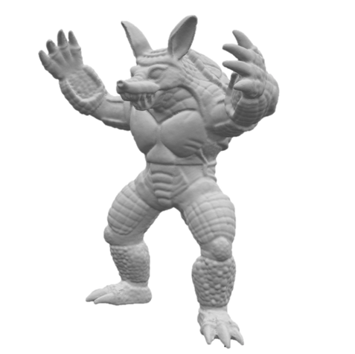
Reduced Precision
(6-bit exponent, 20-bit mantissa)
Original FP64
(11-bit exponent, 52-bit mantissa)
B
Click an object to check its rendered image!

